Slide 1
Business Analytical Report for Sunshine Resort
By: AGILE GROUP

Slide 2
Executive Summary
This report aims to provide actionable insights and data-driven recommendations to enhance guest experiences, optimize hotel operations, and maximize revenue from the analysis of Sunshine Resort’s business data.

Slide 3
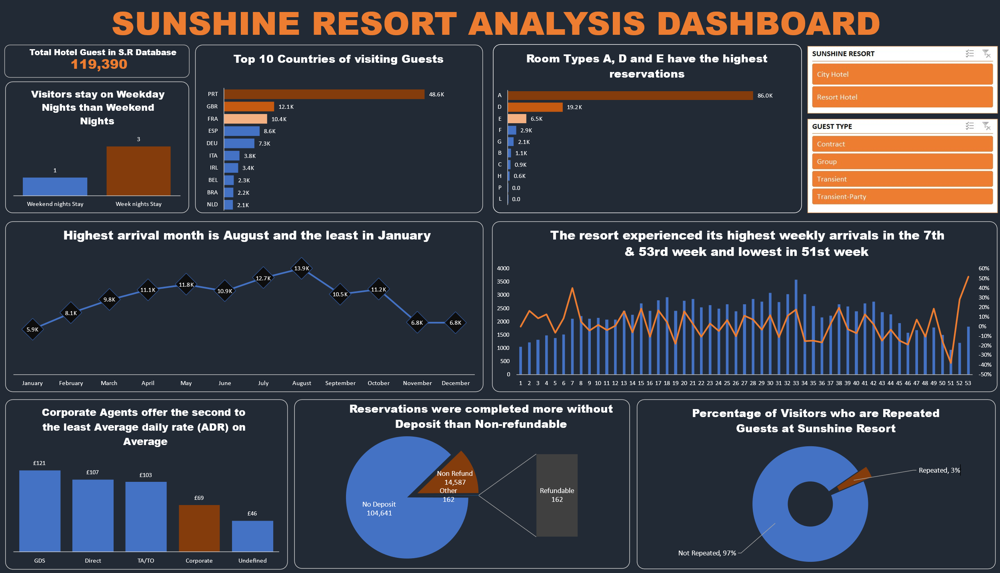

Slide 4
Table of Contents
Hotel Segment Performance
Guest Demographics
Length of Stay
Revenue and Pricing
Booking Trends
Preferred Room Type
Guest Categories
Concluding Remarks

Slide 5
Hotel Segment Performance
Insights:
Total Guests in Sunshine Resort: 119,390
City Hotel: 79,330 guests
Resort Hotel: 40,060 guests
Recommendations:
The management team
Allocate resources to better cater to the City Hotel's higher guest volume.
Develop distinct marketing strategies to elevate the unique attributes of both the City and Resort hotels.

Slide 6
Guest Demographics
Insights:
Dominant Nationalities: Portugal (Especially), followed by UK, France, Spain.
Recommendations:
The management of Sunshine Resort should:
Introduce culturally tailored experiences to engage guests from dominant nationalities.
Foster partnerships with travel agencies in these countries.

Slide 7
Length of Stay
Insights:
Averagely, the
Weekend stay: 1 night
Weekday stay: 3 nights
Recommendations:
The management of Sunshine Resort should:
Create special weekend packages to encourage longer stays.
Offer midweek promotions and deals tailored to the longer average weekday night stay.

Slide 8
Revenue and Pricing
Insights :
On the average,
The highest ADR is from Global Distribution System (GDS): £121
Corporate Agents has the second to the Lowest ADR with £69 and the lowest in Resort Hotel
Recommendations:
The management of Sunshine Resort should:
Amplify relationships with GDS platforms through Centralized Services for Travel Agents, Broad Reach to travel providers (like airlines, more travel agents) to capitalize on higher ADRs.
Assess the effectiveness and profitability of corporate rates especially in Resort Hotel; adjust as needed.

Slide 9
Booking Trends
Insights:
Peak Season is August corresponding to Significant booking increase in Week 33.
Recommendations:
The management of Sunshine Resort should:
Strategically allocate resources to manage peak seasons and high-booking weeks effectively.
Create targeted campaigns for off-peak periods to balance demand.

Slide 10
Preferred Room Type
Insights:
Most preferred: Room Type A (85,994 reservations)
Least preferred: Room Type L (6 reservations)
Recommendations
The management of Sunshine Resort should:
Invest in enhancing the features renovating less popular room types like room Type A.

Slide 11
Guest Categories
Insights:
Most common Guest type is Transient (89,613 guests), next to Transient-Party (25,124 guests) with Contract and Group type reservation the lowest.
Recommendations:
For Transient guests and Transient-Party guests;
The management should consider offering special packages to encourage repeated bookings and aiming to convert them into Contract and Group Guest type.
For Transient-Party guests, offer special group packages, especially targeting arrivals in October.
Create targeted campaigns to increase demand from Contract and Group Guest type.

Slide 12
Conclusion
Leveraging these insights and implementing the recommendations can place Sunshine Resort in a strong position for future growth. The data-driven approach will enhance both revenue and guest satisfaction, ensuring long-term operational excellence.

Slide 13


